Slide 1
UNIT 3
Servo Motors

Slide 2
Technical requirements
The robot with the Raspberry Pi built in the previous chapters
Screwdrivers—small Phillips
Small pliers or a set of miniature spanners • Nylon bolts and standoffs kit—2.5 mm
A two-axis mini pan-tilt micro servo kit
Two micro SG90/9g or MG90s servo motors, with their hardware and servo horns. The pan-tilt kit may already include the following:
Cutting pliers or side cutters
Safety goggles

Slide 3
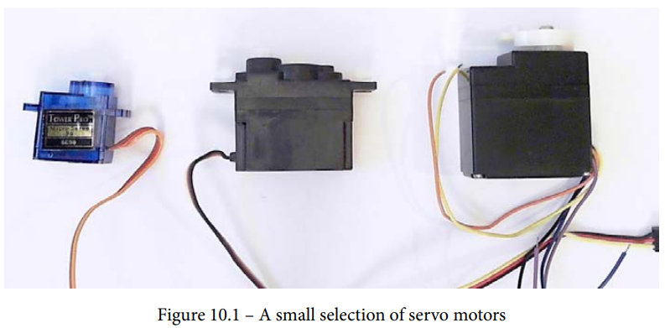
What are servo motors?
Servo motors, or servomechanism motors, are used to position robotic appendages such as arms, grippers, legs, and sensor mounts.

Slide 4
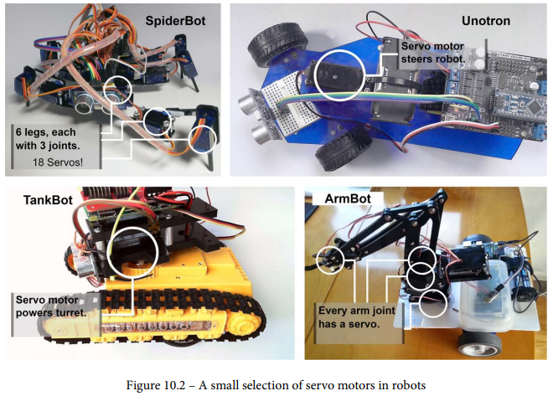

Slide 5
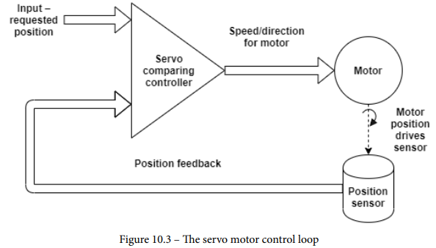
Looking inside a servo

Slide 6
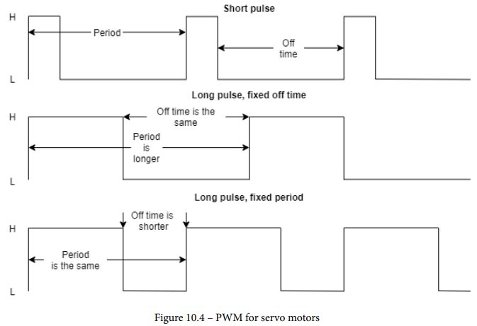
Sending input positions to a servo motor

Slide 7
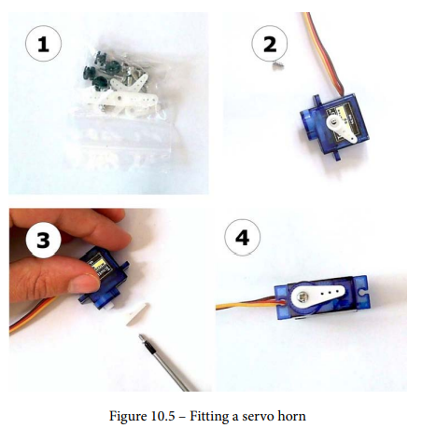
Positioning a servo motor with the Raspberry Pi

Slide 8
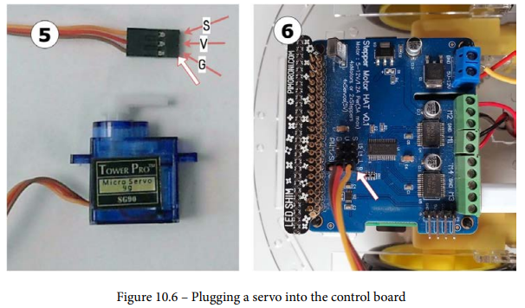

Slide 9
Writing code for turning a servo
Let's make some test code to move a servo to a position typed by the user in degrees. Put this code in servo_type_position.py:
The Raspi_MotorHAT library we are using for the robot has a PWM module, which we import and create an object to manage.
We must specify the address when setting up the PWM device.

Slide 10
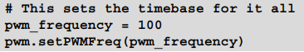
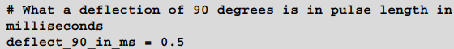
The servo works in cycles at 50 Hz; however, we can use 100 Hz so our motors can drive too.
Let's call the middle position 0 degrees. For most servos, turning to -90 degrees requires a pulse of 1 ms; going to the center requires 1.5 ms:
Turning it to 90 degrees requires a pulse of 2 ms; this is 0.5 ms from the mid-point, which gives us a primary calibration point for 90 degrees:

Slide 11
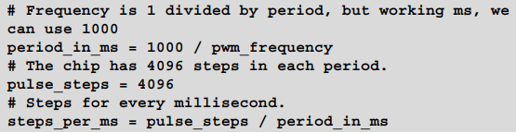
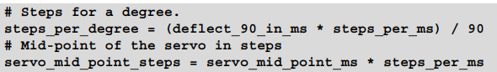
Steps per millisecond:
Now that we have steps per millisecond and know how many milliseconds a pulse should be for 90 degrees, we can get a ratio of steps per degree.

Slide 12
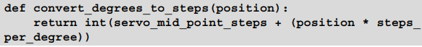
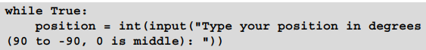
We can use these constants in a convert_degrees_to_pwm function to get the steps needed for any angle in degrees:
Before we move anything, we should make sure the system stops.
We can now ask for user input in a loop.
We can then convert the position to an end step using our preceding calculations:

Slide 13
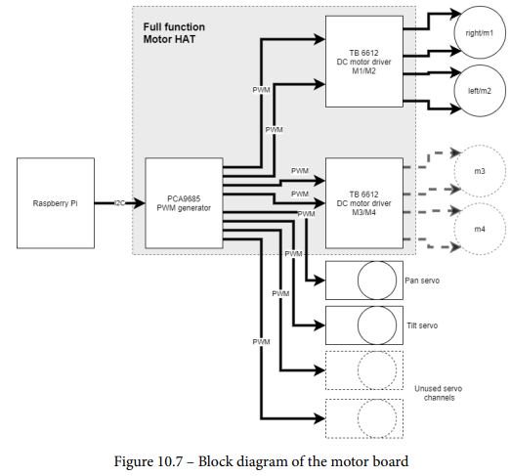
Controlling DC motors and servo motors

Slide 14
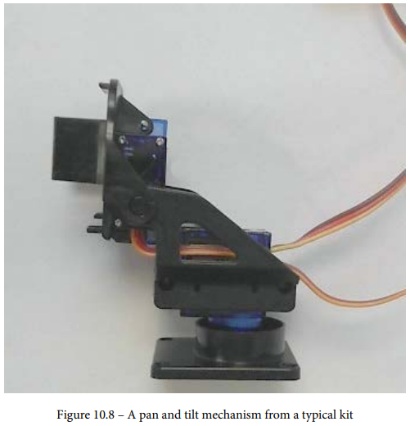
Adding a pan and tilt mechanism

Slide 15
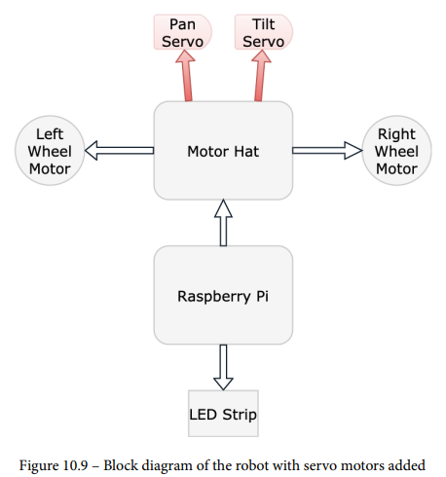

Slide 16
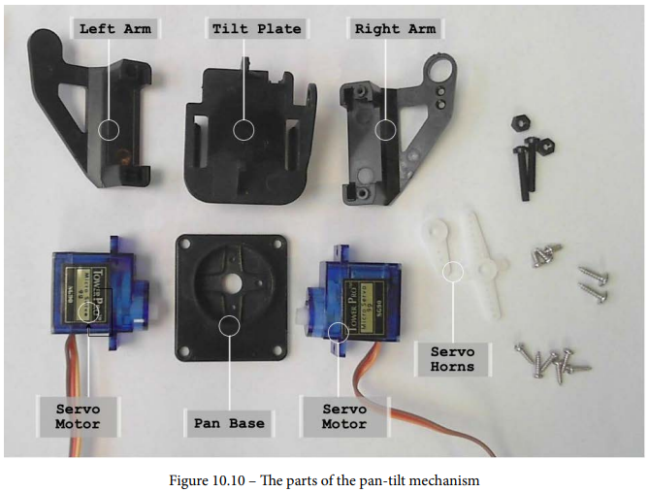
Building the kit

Slide 17
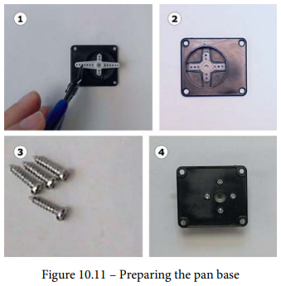

Slide 18
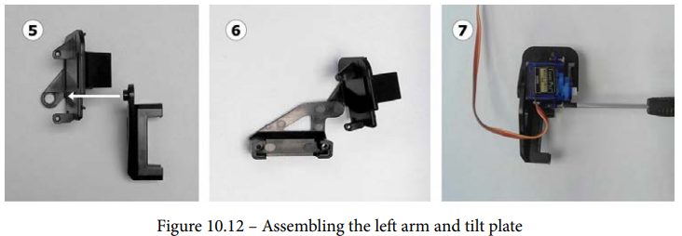
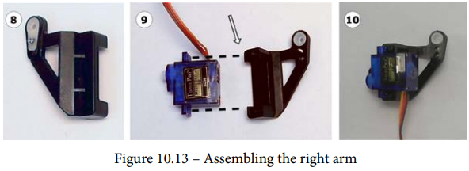

Slide 19
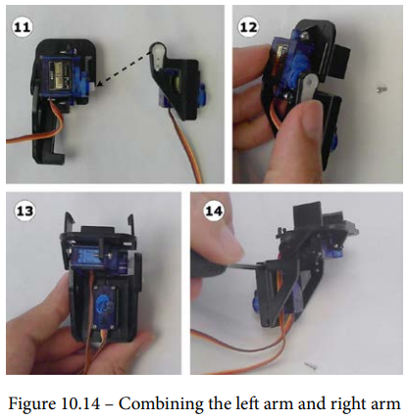

Slide 20
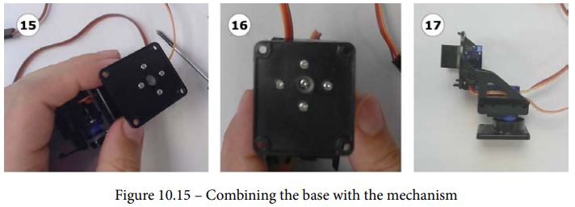

Slide 21
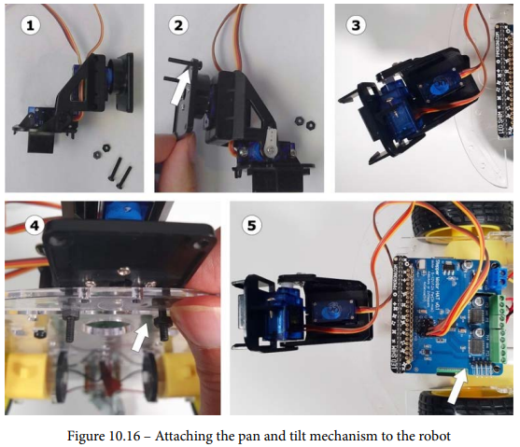
Attaching the pan and tilt mechanism to the robot

Slide 22
https://www.youtube.com/watch?v=4A7tJ0QH4L4

Slide 23
Distance Sensors
Technical Requirements
The Raspberry Pi robot and the code from the previous chapters.
Two HC-SR04P, RCWL-1601, or Adafruit 4007 ultrasonic sensors. They must have a 3.3 V output.
A breadboard.
22 AWG single-core wire or a pre-cut breadboard jumper wire kit.
A breadboard-friendly single pole, double toggle (SPDT) slide switch.
Male-to-female jumpers, preferably of the joined-up jumper jerky type.
Two brackets for the sensor.
A crosshead screwdriver.
Miniature spanners or small pliers.

Slide 24
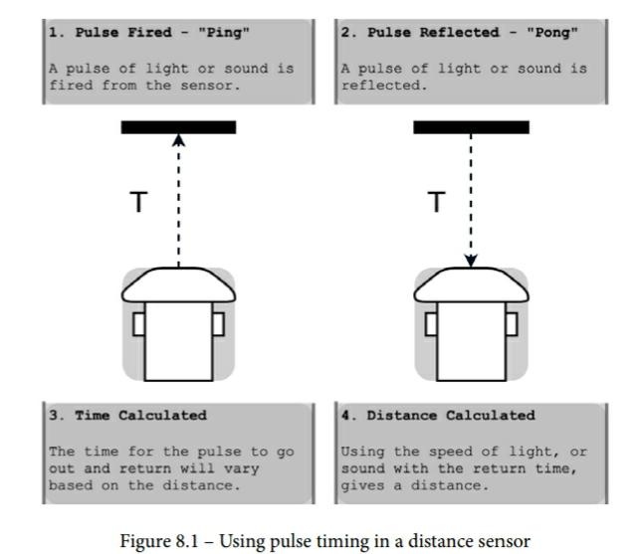
Choosing between optical and ultrasonic sensors

Slide 25
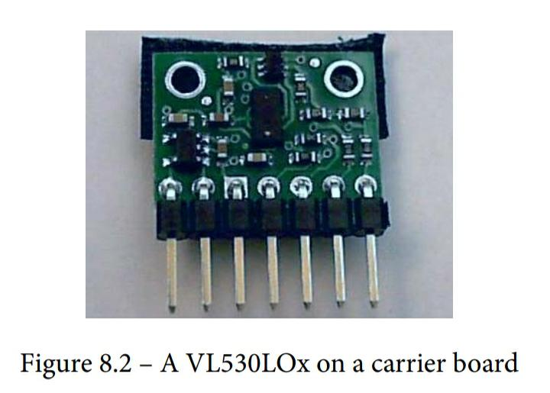
Optical sensors

Slide 26
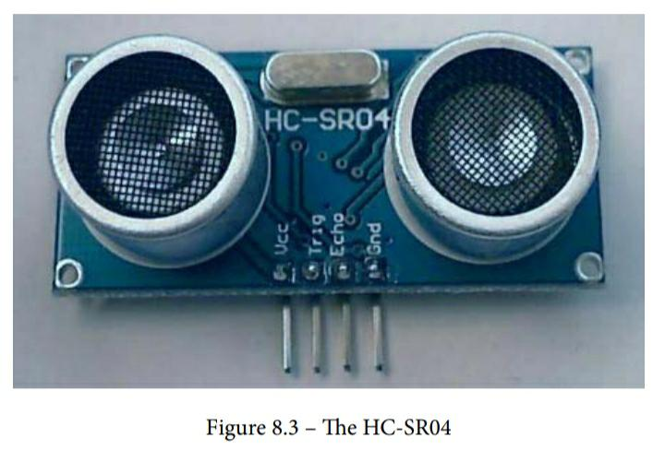
Ultrasonic sensors

Slide 27
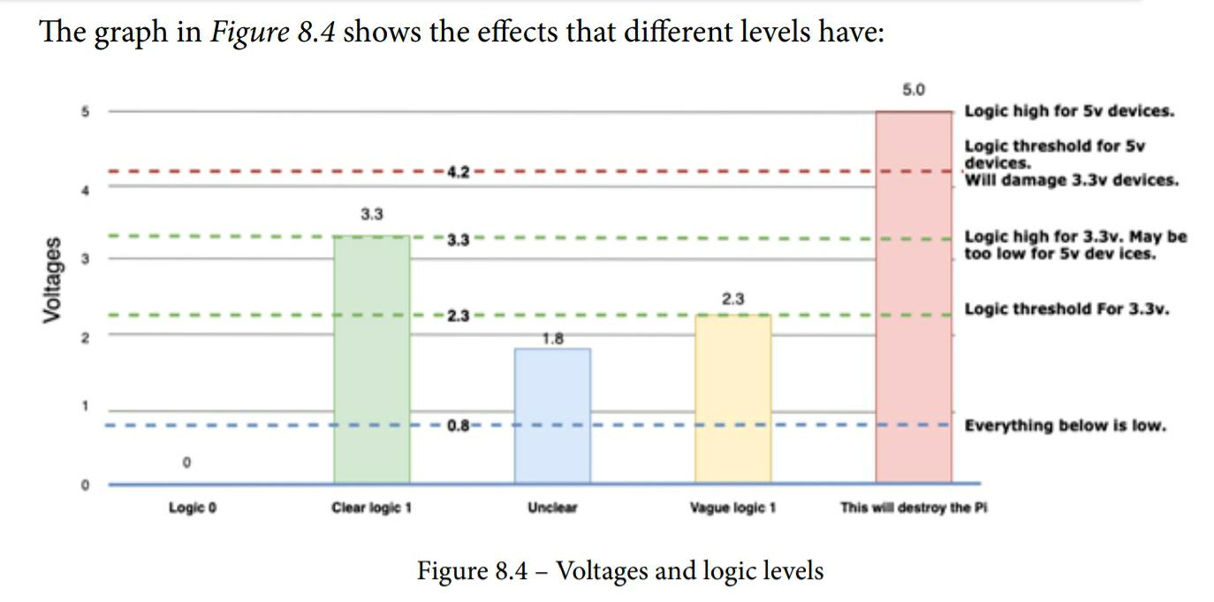
Logic levels and shifting

Slide 28
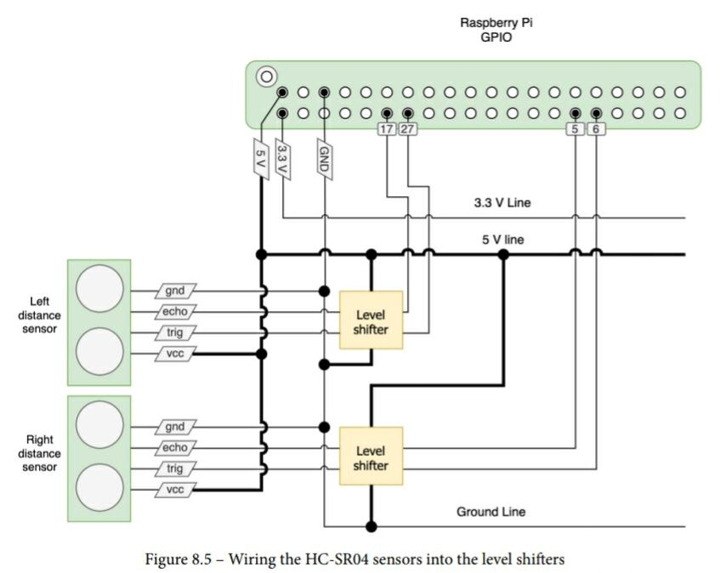

Slide 29
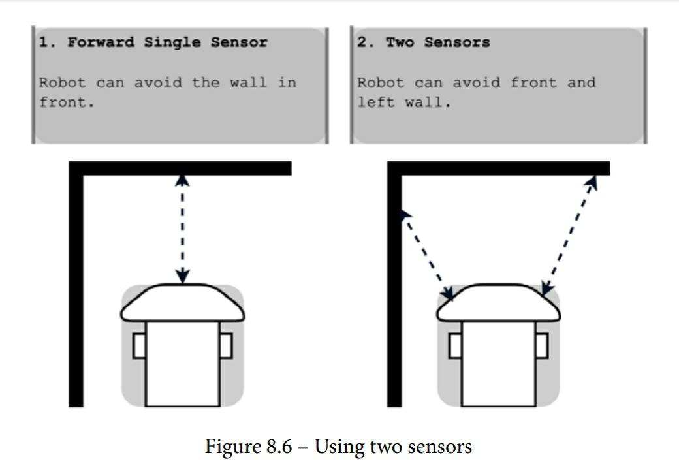
Why use two sensors?

Slide 30
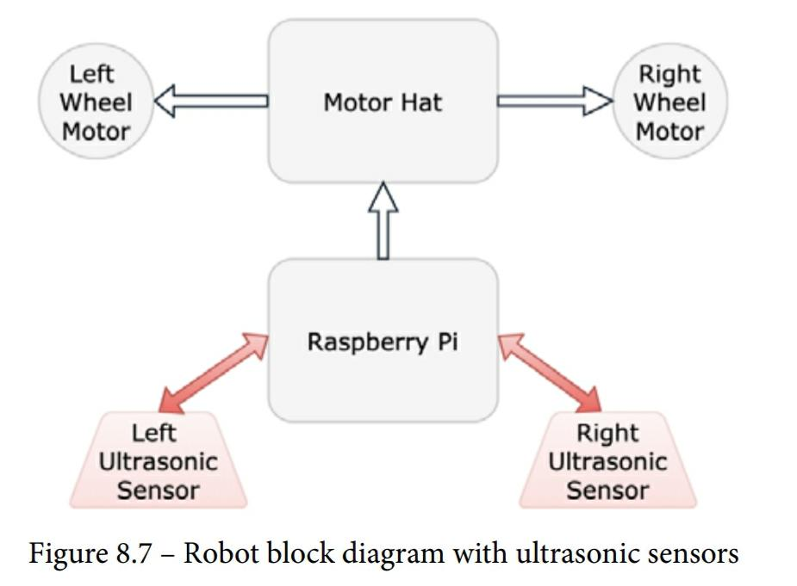
Attaching and reading an ultrasonic sensor

Slide 31
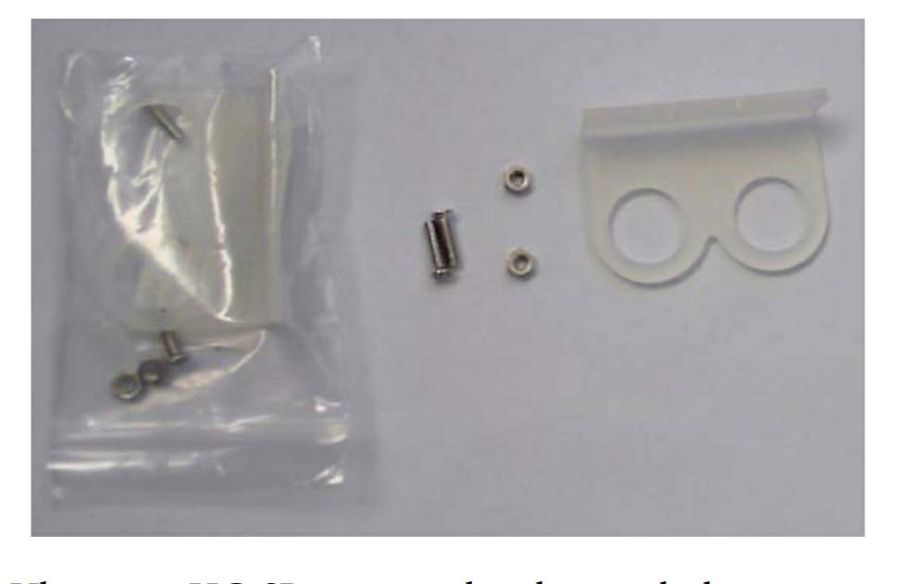
Securing the sensors to the robot

Slide 32
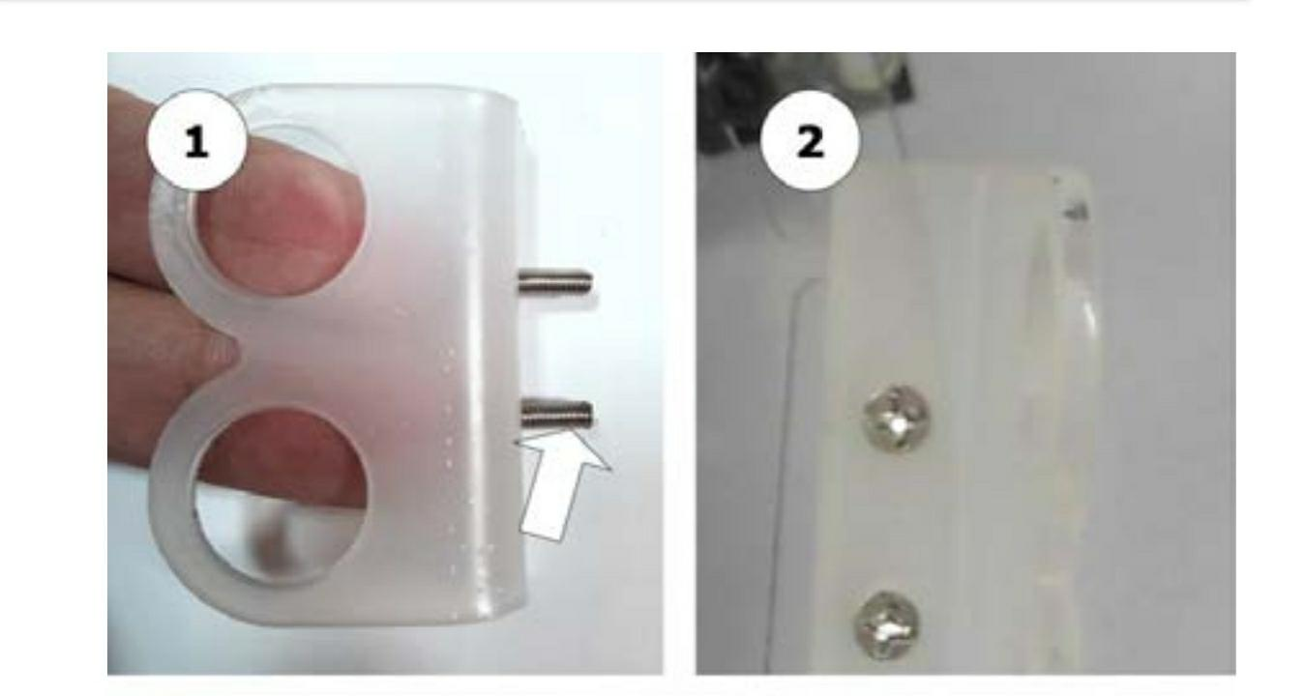

Slide 33
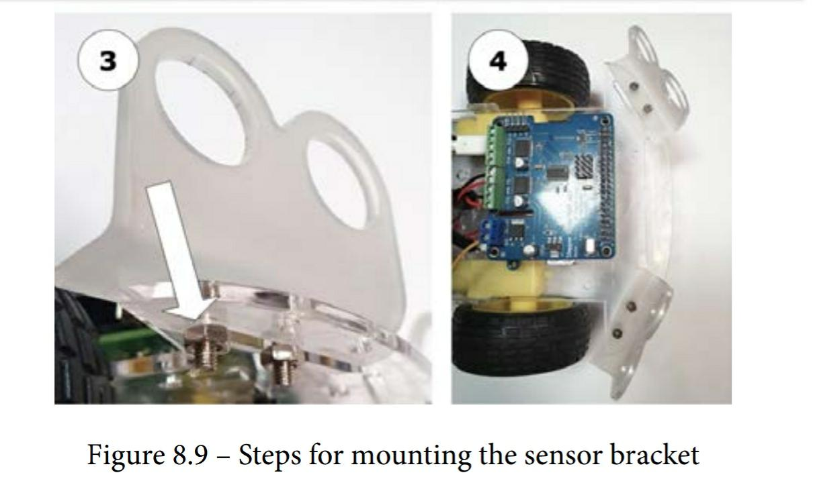

Slide 34
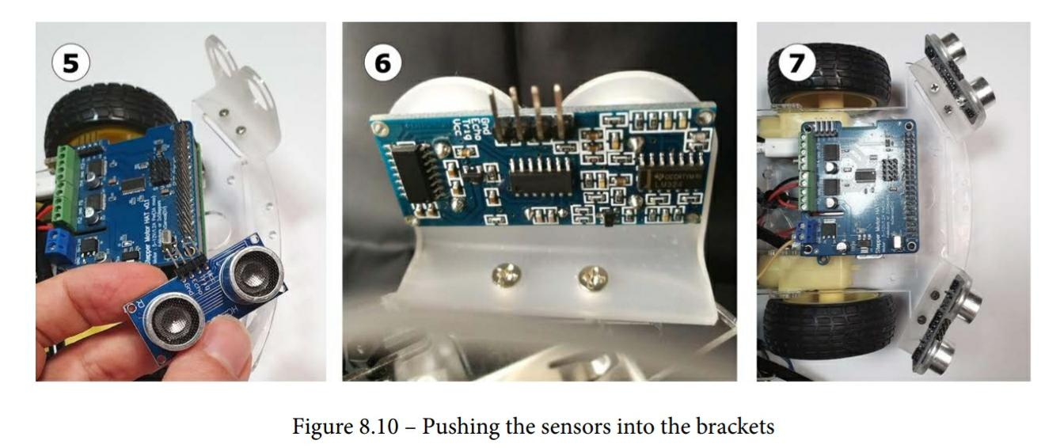

Slide 35
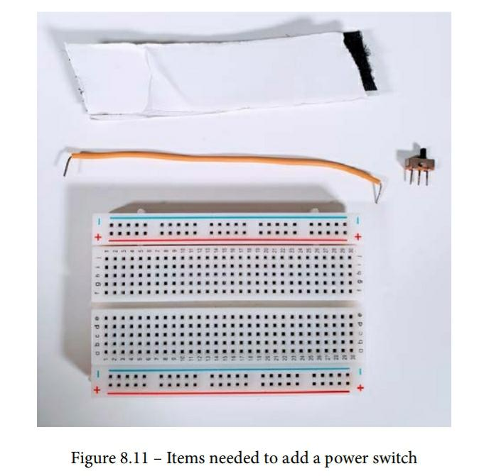
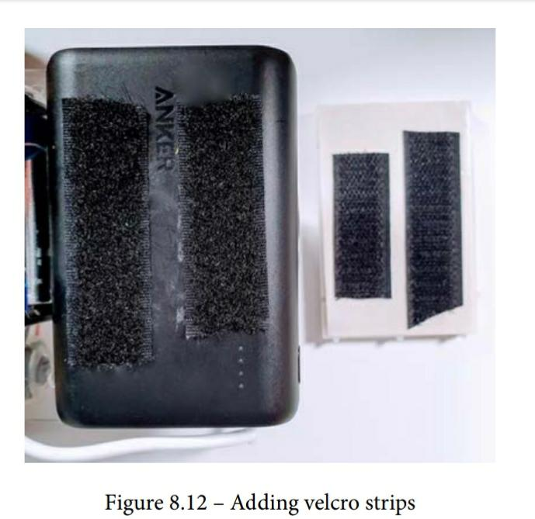
Adding a power switch

Slide 36
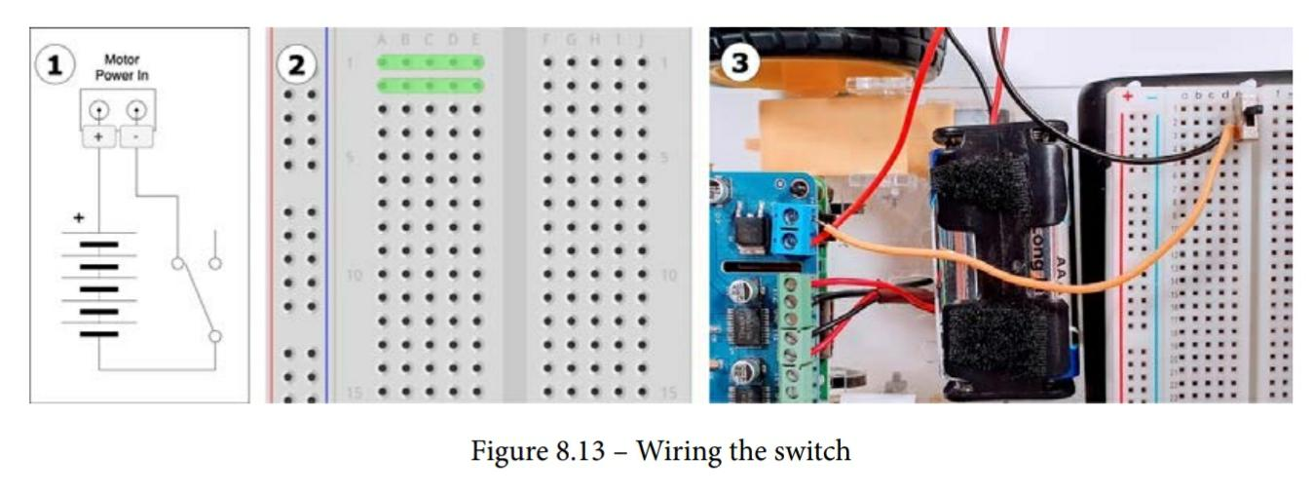

Slide 37
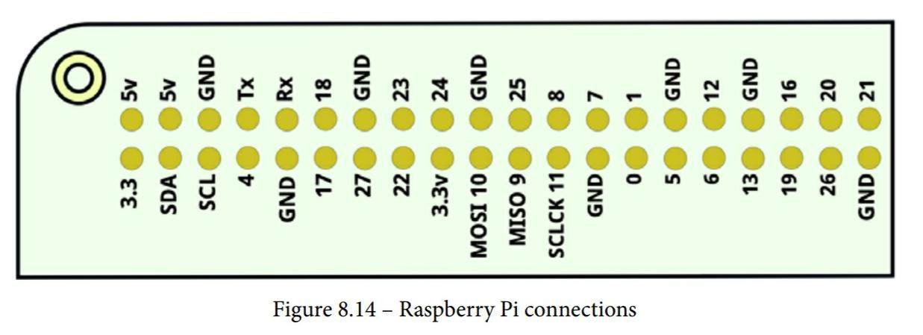
Wiring the distance sensors

Slide 38
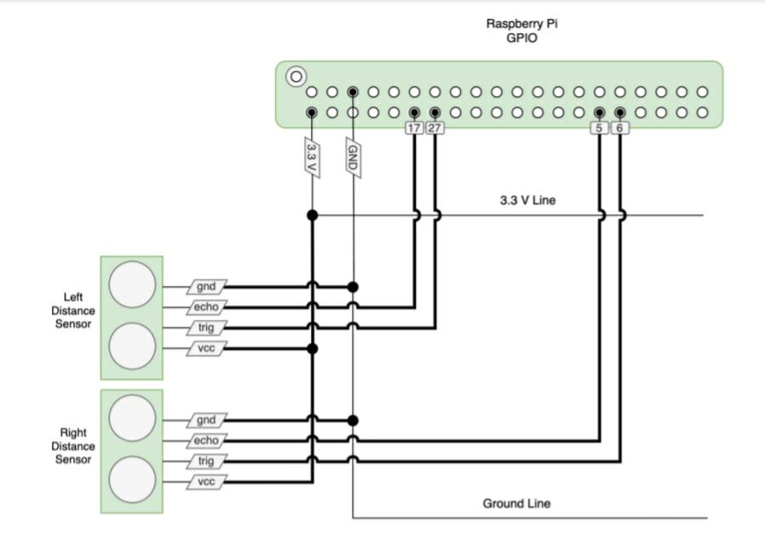

Slide 39
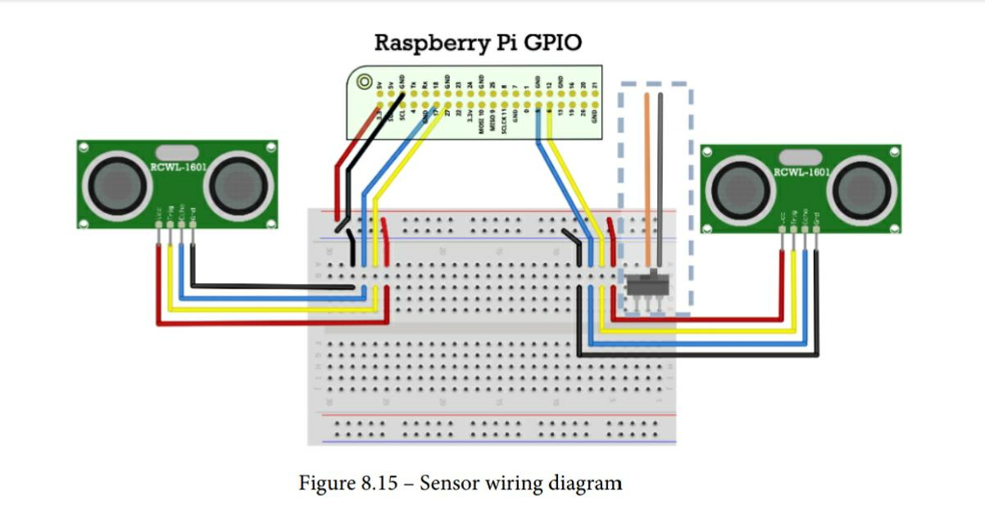

Slide 40
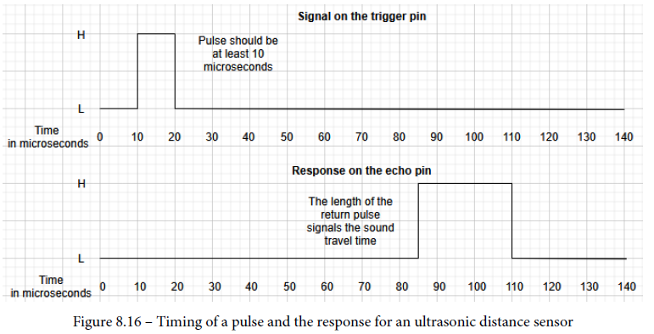
Installing Python libraries to communicate with the sensor
To work with the GPIO sensor, and some other hardware, you need a Python library.
Reading an ultrasonic distance sensor

Slide 41
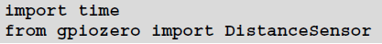
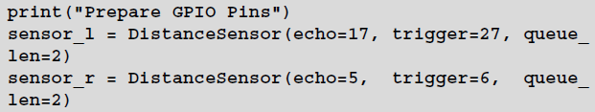
Create a file test_distance_sensors.py:
Begin by importing time and the DistanceSensor library:
Next, we set up the sensors.
This test then runs in a loop until we cancel it:

Slide 42
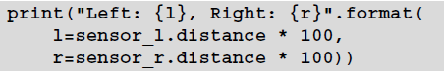
We then print the distance from our sensors.
A little sleep in the loop stops it flooding the output too much and prevents tight looping:
Now, you can turn on your Raspberry Pi and upload this code.
Put an object anywhere between 4 centimeters and 1 meter away from the sensor.

Slide 43
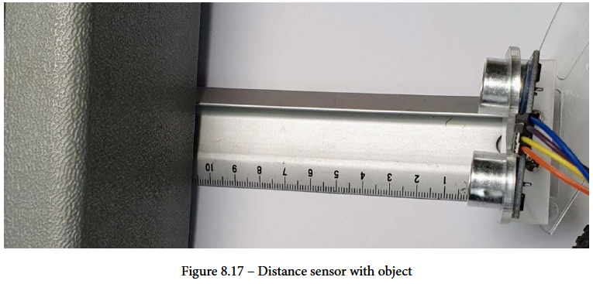

Slide 44
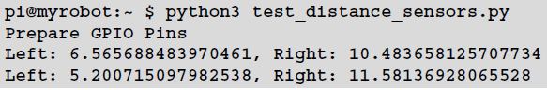
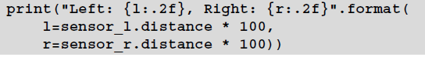
Start the code on the Pi with python3 test_distance_sensors.py. As you move around the object, your Pi should start outputting distances:
Because it is in a loop, you need to press Ctrl + C to stop the program running.
You'll see here that there are many decimal places, which isn't too helpful here.

Slide 45
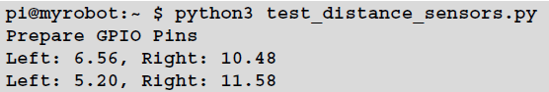
Running the code with this change gives the following output:

Slide 46
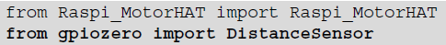
Avoiding walls – writing a script to avoid obstacles
Adding the sensors to the robot class
To use the DistanceSensor object, we need to import it from gpiozero.

Slide 47
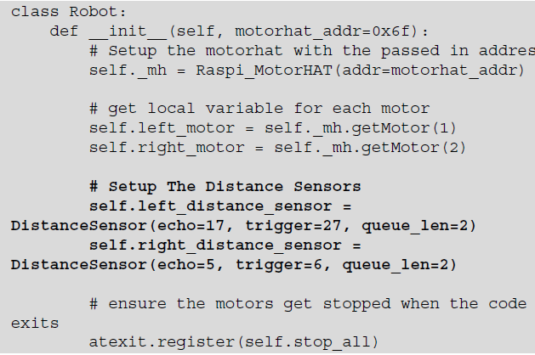
We create an instance of one of these DistanceSensor objects for each side in the robot class.

Slide 48
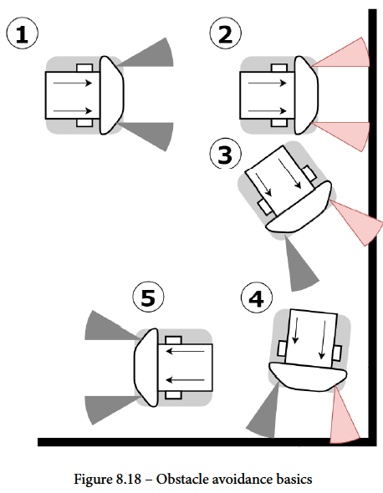
Making the obstacle avoid behaviors

Slide 51

First attempt at obstacle avoidance

Slide 52


simple_avoid_behavior.py:
Start by importing the robot, and sleep for timing:
The following class is the basis of our behavior.

Slide 53



Now the following method chooses a speed for each motor, depending on the distance detected by the sensor.
The run method is the core, since it has the main loop.

Slide 54



Now, we start the main loop:
We then print out our readings on the console:
Now, we use the distances with our get_motor_speed method and send this to each motor:

Slide 55

Since this is our main loop, we wait a short while before we loop again. Under this is the setup and starting behavior:

Slide 56
Encoders
Technical requirements
Two slotted speed sensor encoders. Search for slotted speed sensor, Arduino speed sensor, LM393 speed sensor, or the Photo Interrupter sensor module. Include the term 3.3 V to ensure its compatible. See the The encoders we are using section for images of these.
Long male-to-female jumper cables.
A ruler to measure the wheels' size on your robot – or better yet, calipers, if you can use them.

Slide 57

Measuring the distance traveled with encoders
Where machines use encoders
Types of encoders

Slide 58

Encoding absolute or relative position

Slide 59

Encoding direction and speed

Slide 60

The encoders we are using

Slide 61


Preparing the encoders
Lifting the Raspberry Pi

Slide 62

Attaching encoders to the robot

Slide 63


Slide 64

Fitting the encoders onto the chassis

Slide 65

Wiring the encoders to the Raspberry Pi

Slide 66

Detecting the distance traveled in Python
Introducing logging
Simple counting
Let's make a file called test_encoders.py, starting with the usual robot classes, import and time, and adding logging:

Slide 67


Next, we add an import for a GPIO Zero input device. We can use the pin it sets up to count our pulses:
The encoders generate pulses; we want to count them and track their state.

Slide 68


Still in the constructor, we need to set up the device and how we count pulses with it.
We need to define a when_changed method for our class to add one to pulse_ count.
We can set up our robot object and create an EncoderCounter for each side's sensor.

Slide 69

To display values, instead of just using sleep, we loop, checking against an end time.
Since tight loops can cause things to break (such as GPIO Zero calling our code from a sensor thread), it should sleep a little too:

Slide 70


Slide 71

Adding encoders to the Robot object
Extracting the class
Let's start by adding the imports and class declaration.
I'm adding a direction member to account for reversing:

Slide 72

The constructor (__init__) is finished by setting up the device and assigning a when_changed handler:
Our when_changed handler should add the direction instead of 1, so it can count up or down:
We should also have a method to set this direction.

Slide 73


A reset method means we can handle restarting counters between movements:
For cleanup, we need a way to stop the counters so that they don't call the handler again:

Slide 74


Adding the device to the Robot object
Start by importing EncoderCounter:
In the __init__ constructor method, we need to set up left and right encoders.

Slide 75

To make sure that the code cleans up encoder handlers when our Robot object has stopped, we call the encoder's stop methods in the stop_all method:

Slide 76


Turning ticks into millimeters

Slide 77



Make a new file called test_distance_travelled.py.
Next, we define our constants – the wheel's diameter and the number of ticks per revolution.
Create a function to convert the ticks counted into a distance.

Slide 78


Next, we define our robot, set up a stop time, and start the motors:
In the loop, we display the distance by calling ticks_to_mm on the pulse counts:

Slide 79


Slide 80
Unit 1:
Chapter 1 and 2
Unit 2:
Chapter 6, 9 and 14
Unit 3:
Chapter 8,10 and 11
Unit 4:
Chapter 14 and 15

